Slide 1

Bridging Grid Islands for Large Scale e-Science
Blair Bethwaite, David Abramson, Ashley Buckle

Slide 2



Why Interoperate?
Increasing uptake of e-Research techniques is increasing demand for Grid resources.
Infrastructure investment requires users and apps – chicken and egg.
Need it done yesterday!
Drive Grid evolution.

Slide 3

Interop is hard!
One Grid is challenging enough, try using five at once.
What’s the problem?
Grids are built with varying specifications and until recently, little regard for best practice.
Minor differences in software stacks can manifest as complex problems.
Varying levels of Grid maturity make for an inconsistent working environment.

Slide 4
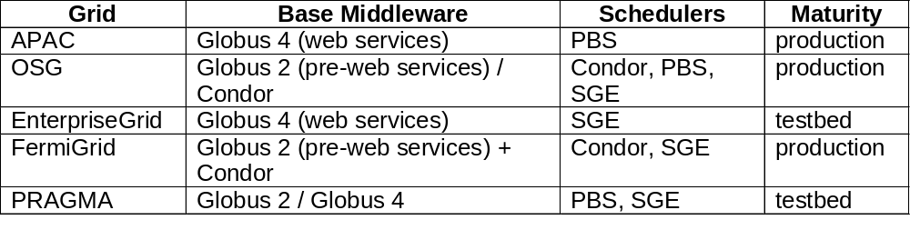
The Testbed
Five Grids of varying maturity.
Three virtual organisations: Monash, GIN, Engage.

Slide 5
Interop Issues
Identified five categories where we had problems:
  Access & security:
    International Grid Trust Federation makes authn easy.
    GIN VO does not support interoperations (test only).
      Still necessary to deal with multiple Grid admins to gain access to locally trusted VO/s.
    Current VOMS implementation (users sharing a single real account) presents risk in loosely coupled VOs.
  Resource discovery:
    Big gap between production and testbed Grids in information services.
    Need to make these services easier to provide and maintain.

Slide 6
Interop Issues cont.
  Usage guidelines / AUPs
    How should I use your machines? Where do install my app?
      A standard execution environment has been a long time coming! There is a recent GIN draft [1]. Recommend GIN-ops Grids must comply.
E.g. Phaser deployment required scripts written and customised for each Grid. Too hard for a regular e-Science user!
if [ ! -z ${OSG_APP} ] ; then
echo "\$OSG_APP is $OSG_APP"
APP_DIR=${OSG_APP}/engage/phaser
elif [ -w ${HOME} ] ; then
echo "Using \$HOME:$HOME..."
APP_DIR=${HOME}/phaser
else
echo "Can't find a deployment dir!"
exit 1
fi
[1] Morris Riedel, “Execution Environment,” OGF Gridforge GIN-CG; http://forge.ogf.org/sf/go/doc15010?nav=1.

Slide 7

Interop Issues cont.
  Application compatibility:
    Some inputs caused long and large, i.e. in excess of 2GB virtual memory, searches.
    On machines with vmem_limit < 2GB this caused job termination part way through the job and wasted many CPU hours over the experiments duration.
    These memory requirements crashed some machines on PRAGMA Grid because limits were not defined.
      Not enough to just install SGE/PBS and whack Globus on top, these systems need careful config. and maintenance.
      Why doesn’t the scheduler / middleware handle this? Should be automated!

Slide 8

Interop Issues cont.
  Middleware compatibility:
    Yes, we need standards! But adoption is slow.
    Using GT4 on different Grids and local resource managers / queuing systems is like having a job execution standard. However we still had problems:
      E.g. GT4 PBS interface leaves automatically generated stdout & stderr behind even when they are not requested. Couple this with VOMS and get a denial of service on the shared home directory!!
    Existing standards (e.g. OGSA-BES[1]) have gaps – functionally specific, little regard for side effects. Wouldn’t stop this problem happening again.
?
[1] I. Foster et al., “GFD-R-P.108 OGSA Basic Execution Service,” Aug. 2007; http://www.ogf.org/documents/GFD.108.pdf.

Slide 9
Acknowledgments & Thanks
PRAGMA – especially Cindy Zheng and all resource providers
OSG – Neha Sharma, Mats Rynge, Ruth Pordes
GIN - Oscar Koeroo, Morris Riedel, Erwin Laure
Monash – Steve Androulakis, Colin Enticott, Slavisa Garic

